Slide 1
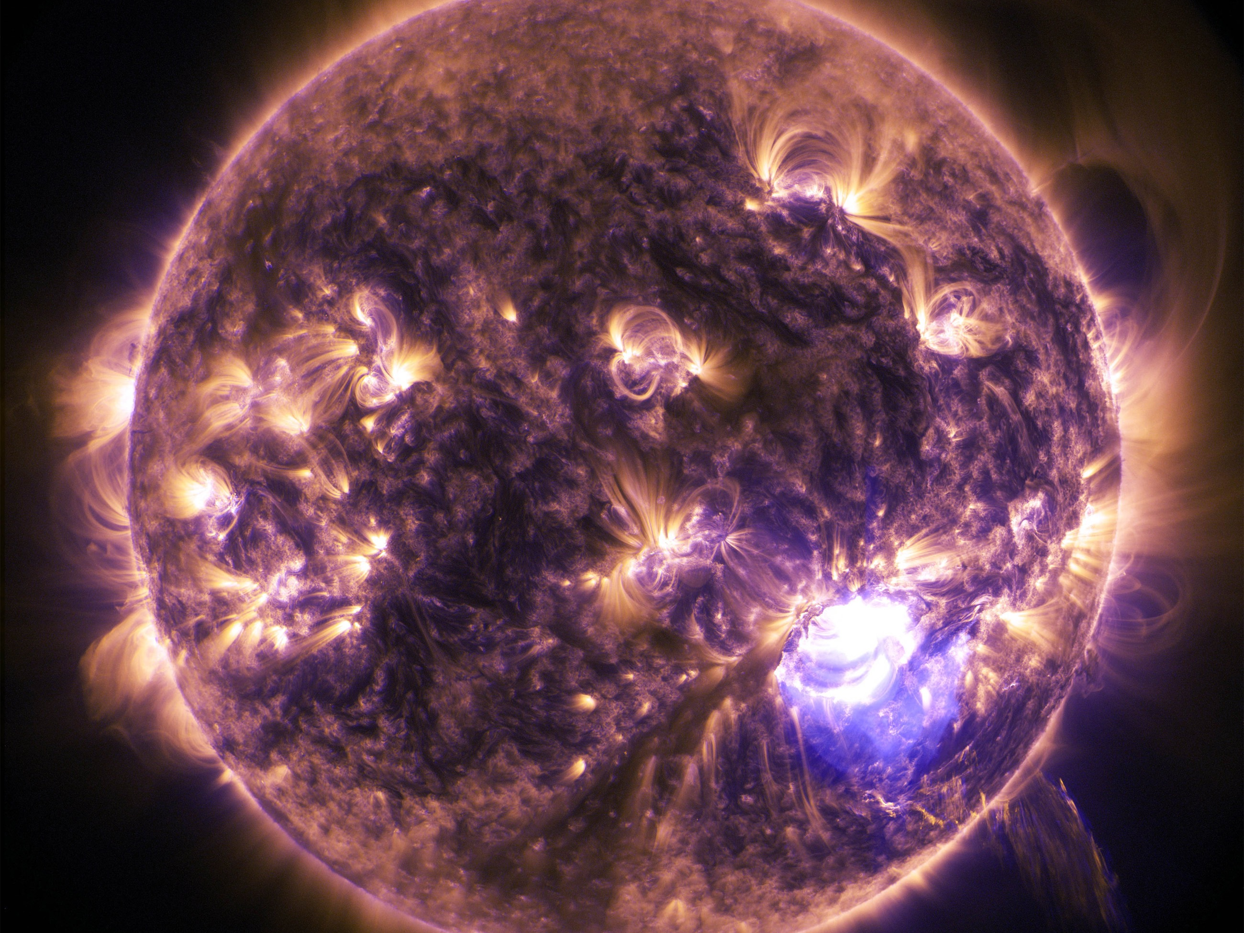
CME arrival-time validation of real-time WSA-ENLIL+Cone simulations at the CCMC/SWRC
Alexandra M. Wold1, M. Leila Mays2,3, A.Taktakishvili2,3, L. Jian4,3, D.Odstrcil2,5, P. MacNeice3
1American University, 2Catholic University of America, 3NASA Goddard Space Flight Center, Code 674, 4University of Maryland, 5George Mason University

Slide 2
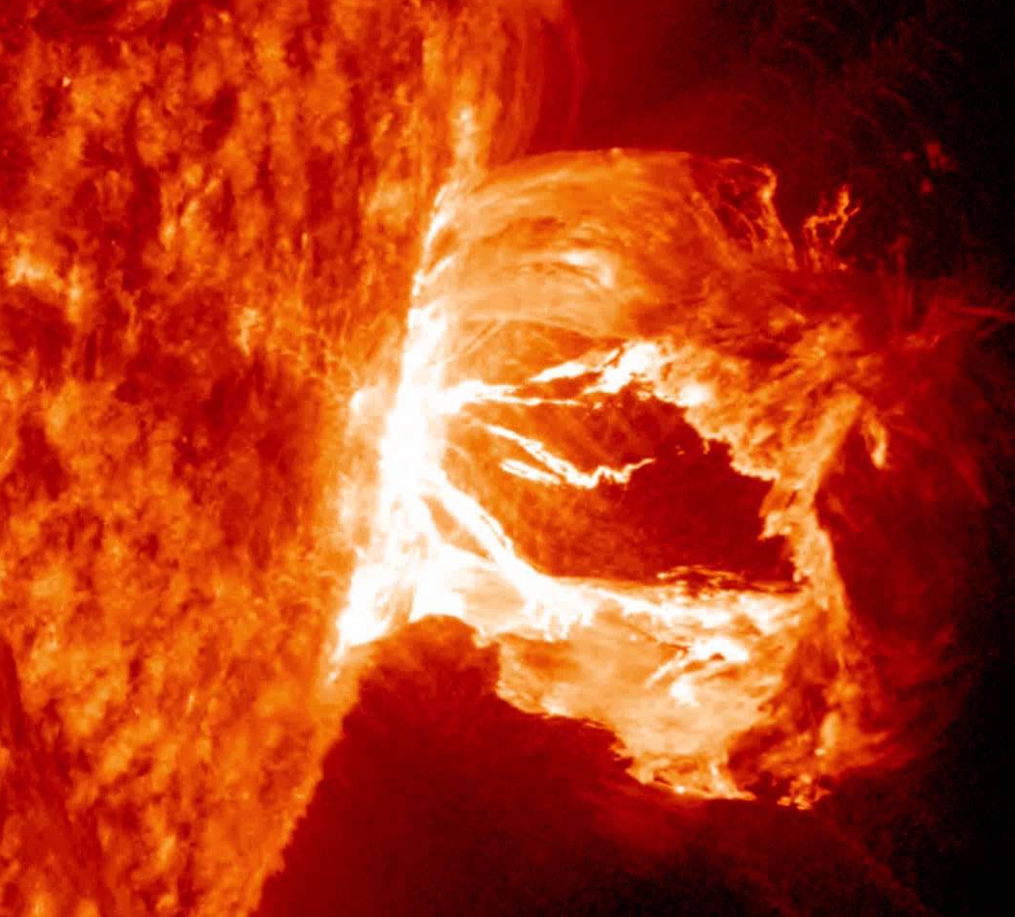
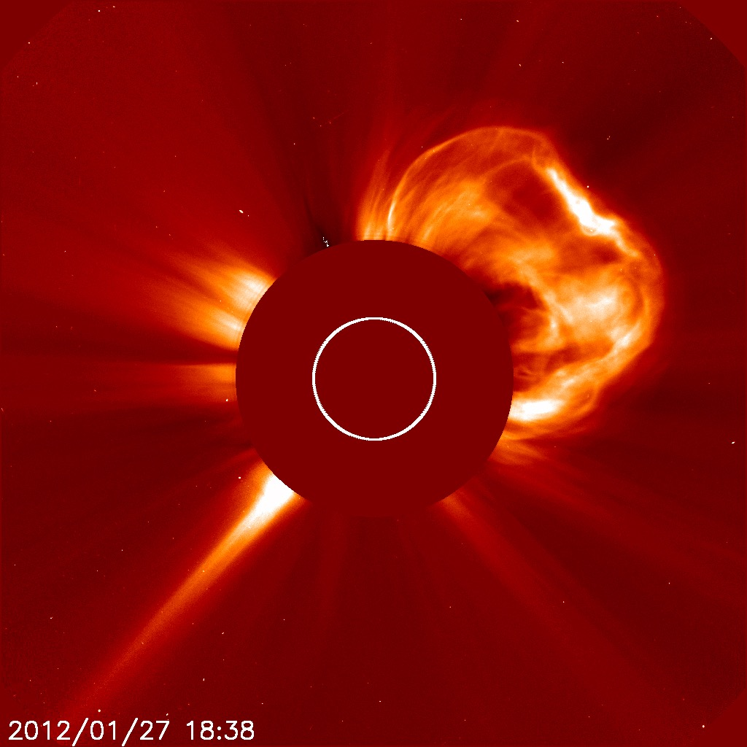
Introduction
Coronal mass ejections (CMEs):
one of the main drivers of space weather
damage spacecraft, cause geomagnetic storms, and disrupt technology on Earth
Great interest from space weather researchers, mission operators, and larger community to predict the arrivals
WSA-ENLIL+Cone Model: used extensively in space weather operations worldwide
Evaluate accuracy of arrival time predictions of over 600 real-time simulations from 2010 - 2013 by comparing to observed arrivals
Hits (CMEs observed to arrive): calculate the CME arrival time error, and the dependence of these errors on CME input parameters.

Slide 3
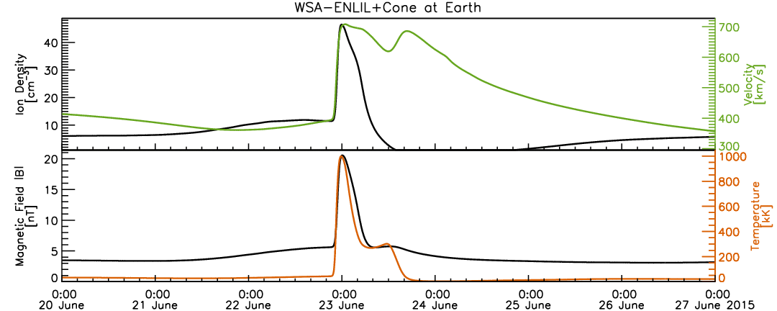
WSA-ENLIL+Cone Model
WSA (Wang-Sheeley-Arge): near-Sun module approximates solar wind outflow at base of solar wind (from magnetogram observations)
inner boundary 21.5 Rs (0.1AU) - wind speed is supersonic
ENLIL: 3-D magnetohydrodynamic numerical model simulates resulting flow evolution to Earth and beyond
CME is injected into ambient conditions (direction, radial speed, half-width) as an over-pressurized sphere of plasma.

Slide 4


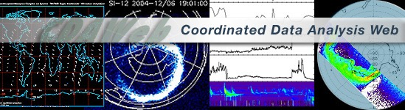


Validation Process
The quality of model operation is evaluated by comparing the model output to the observed CME arrival time.
Analysis of in situ data (ACE, WIND, STEREO)
Consultation of forecaster logs
Referencing ICME catalogues (Lan Jian, Teresa Nieves, Richardson & Cane, ISEST, HELCATS)
Complications:
Observed arrival is weak
Hybrid SIR and CME event
CME arrival with uncertain source.

Slide 5
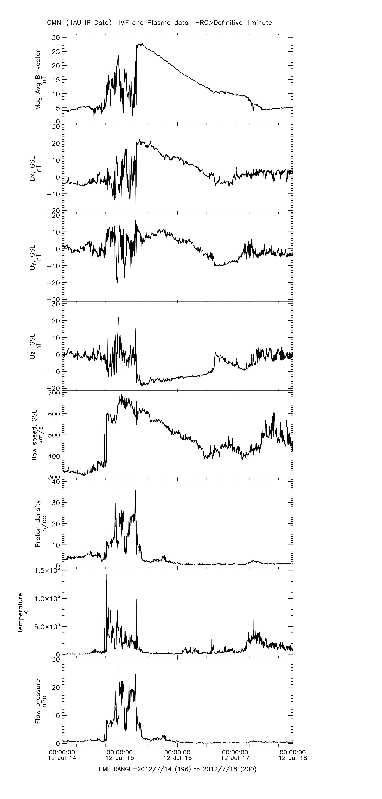
CME arrival Signatures

Slide 6
Contingency Table
 | Observed Arrival | No Observed Arrival
Predicted Arrival | Hit | False Alarm
No Predicted Arrival | Miss | Correct Rejection
Success Ratio: Hits/(Hits+False Alarms)
the fraction of predicted arrivals that were correct
False Alarm Ratio: False Alarms/(Hits+False Alarms)
the fraction of predicted arrivals that were wrong

Slide 7
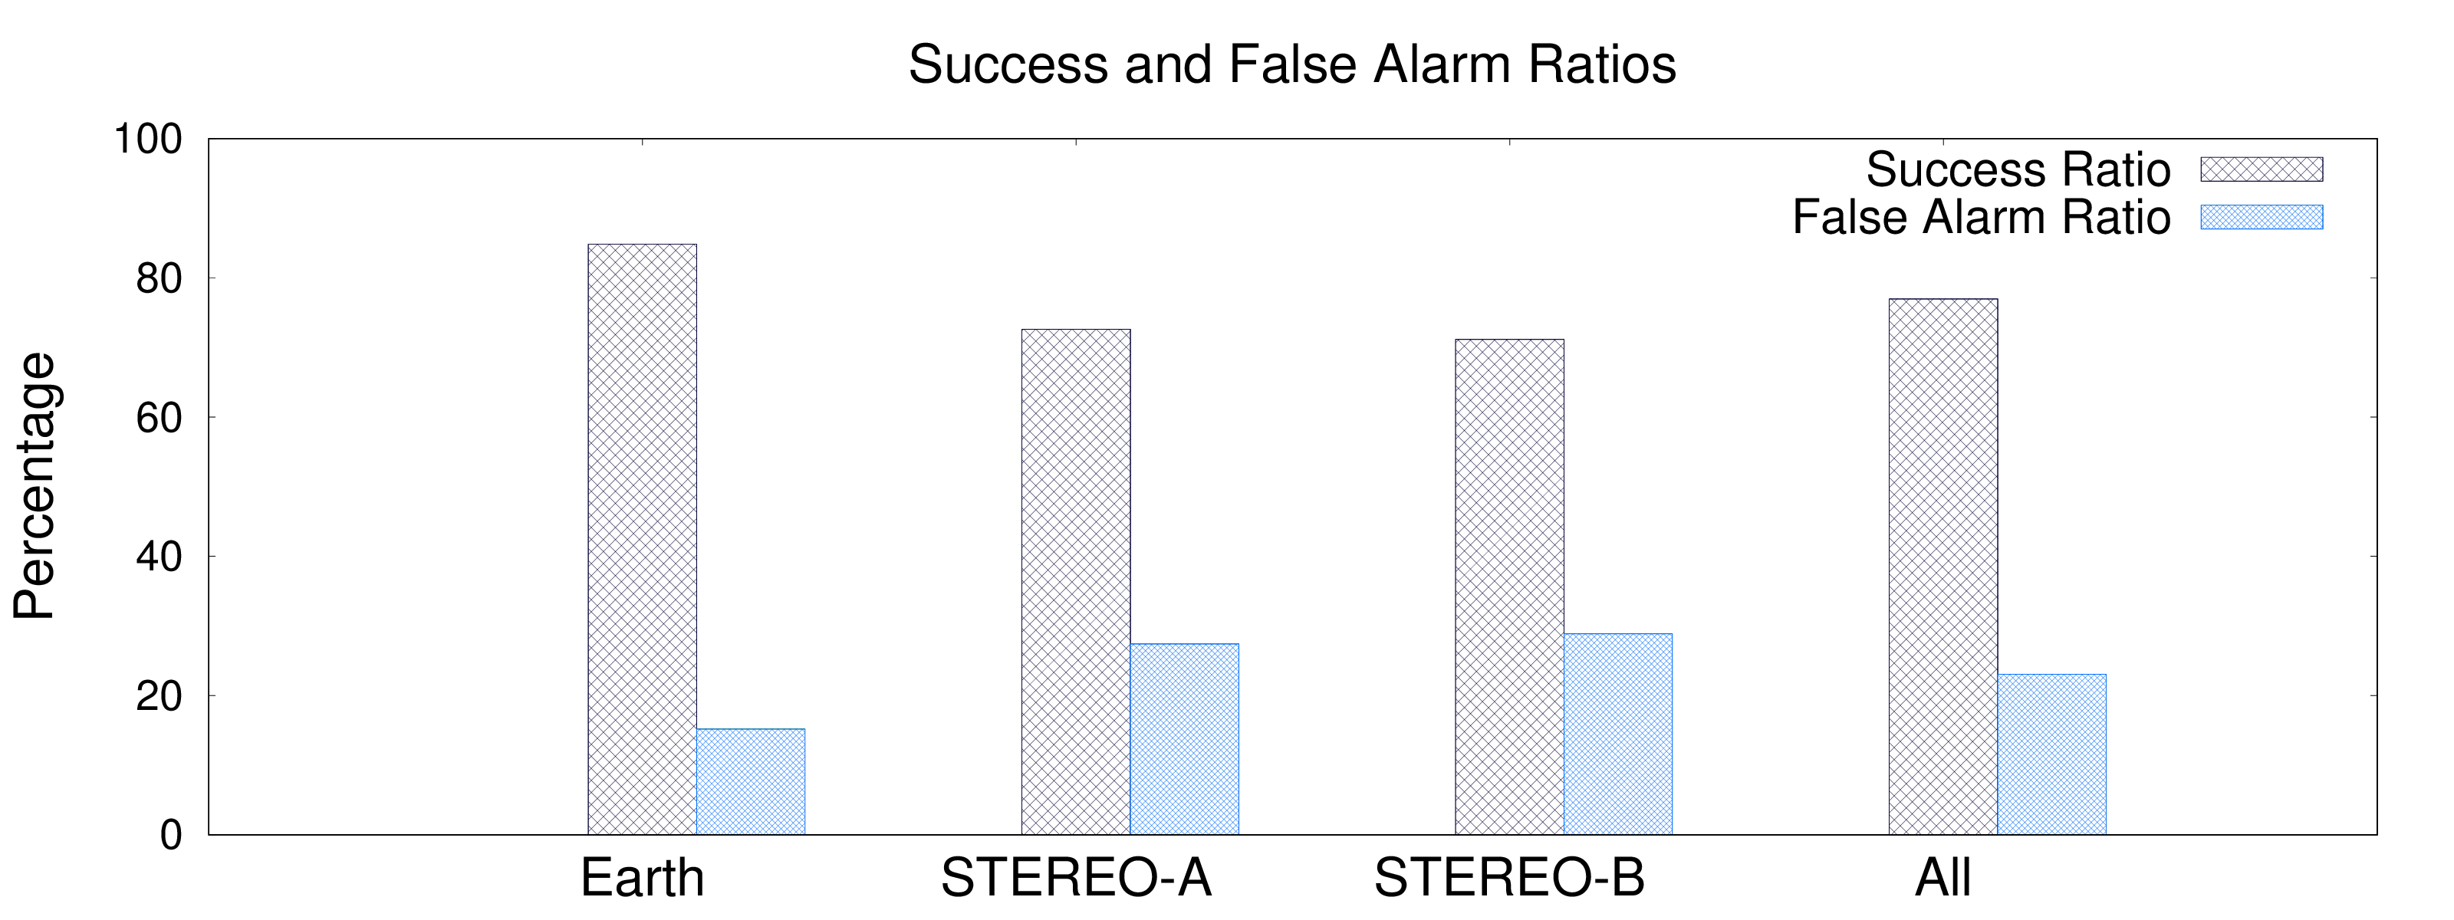
Hit, False Alarm, Miss and Correct Rejection Rates
 | Earth | STEREO-A | STEREO-B | All
Hits | 67 | 53 | 37 | 157
False Alarms | 12 | 20 | 15 | 47
Misses | >6 | >2 | >3 | >11
Correct Rejections | ~410 | ~459 | ~479 | ~1352

Slide 8
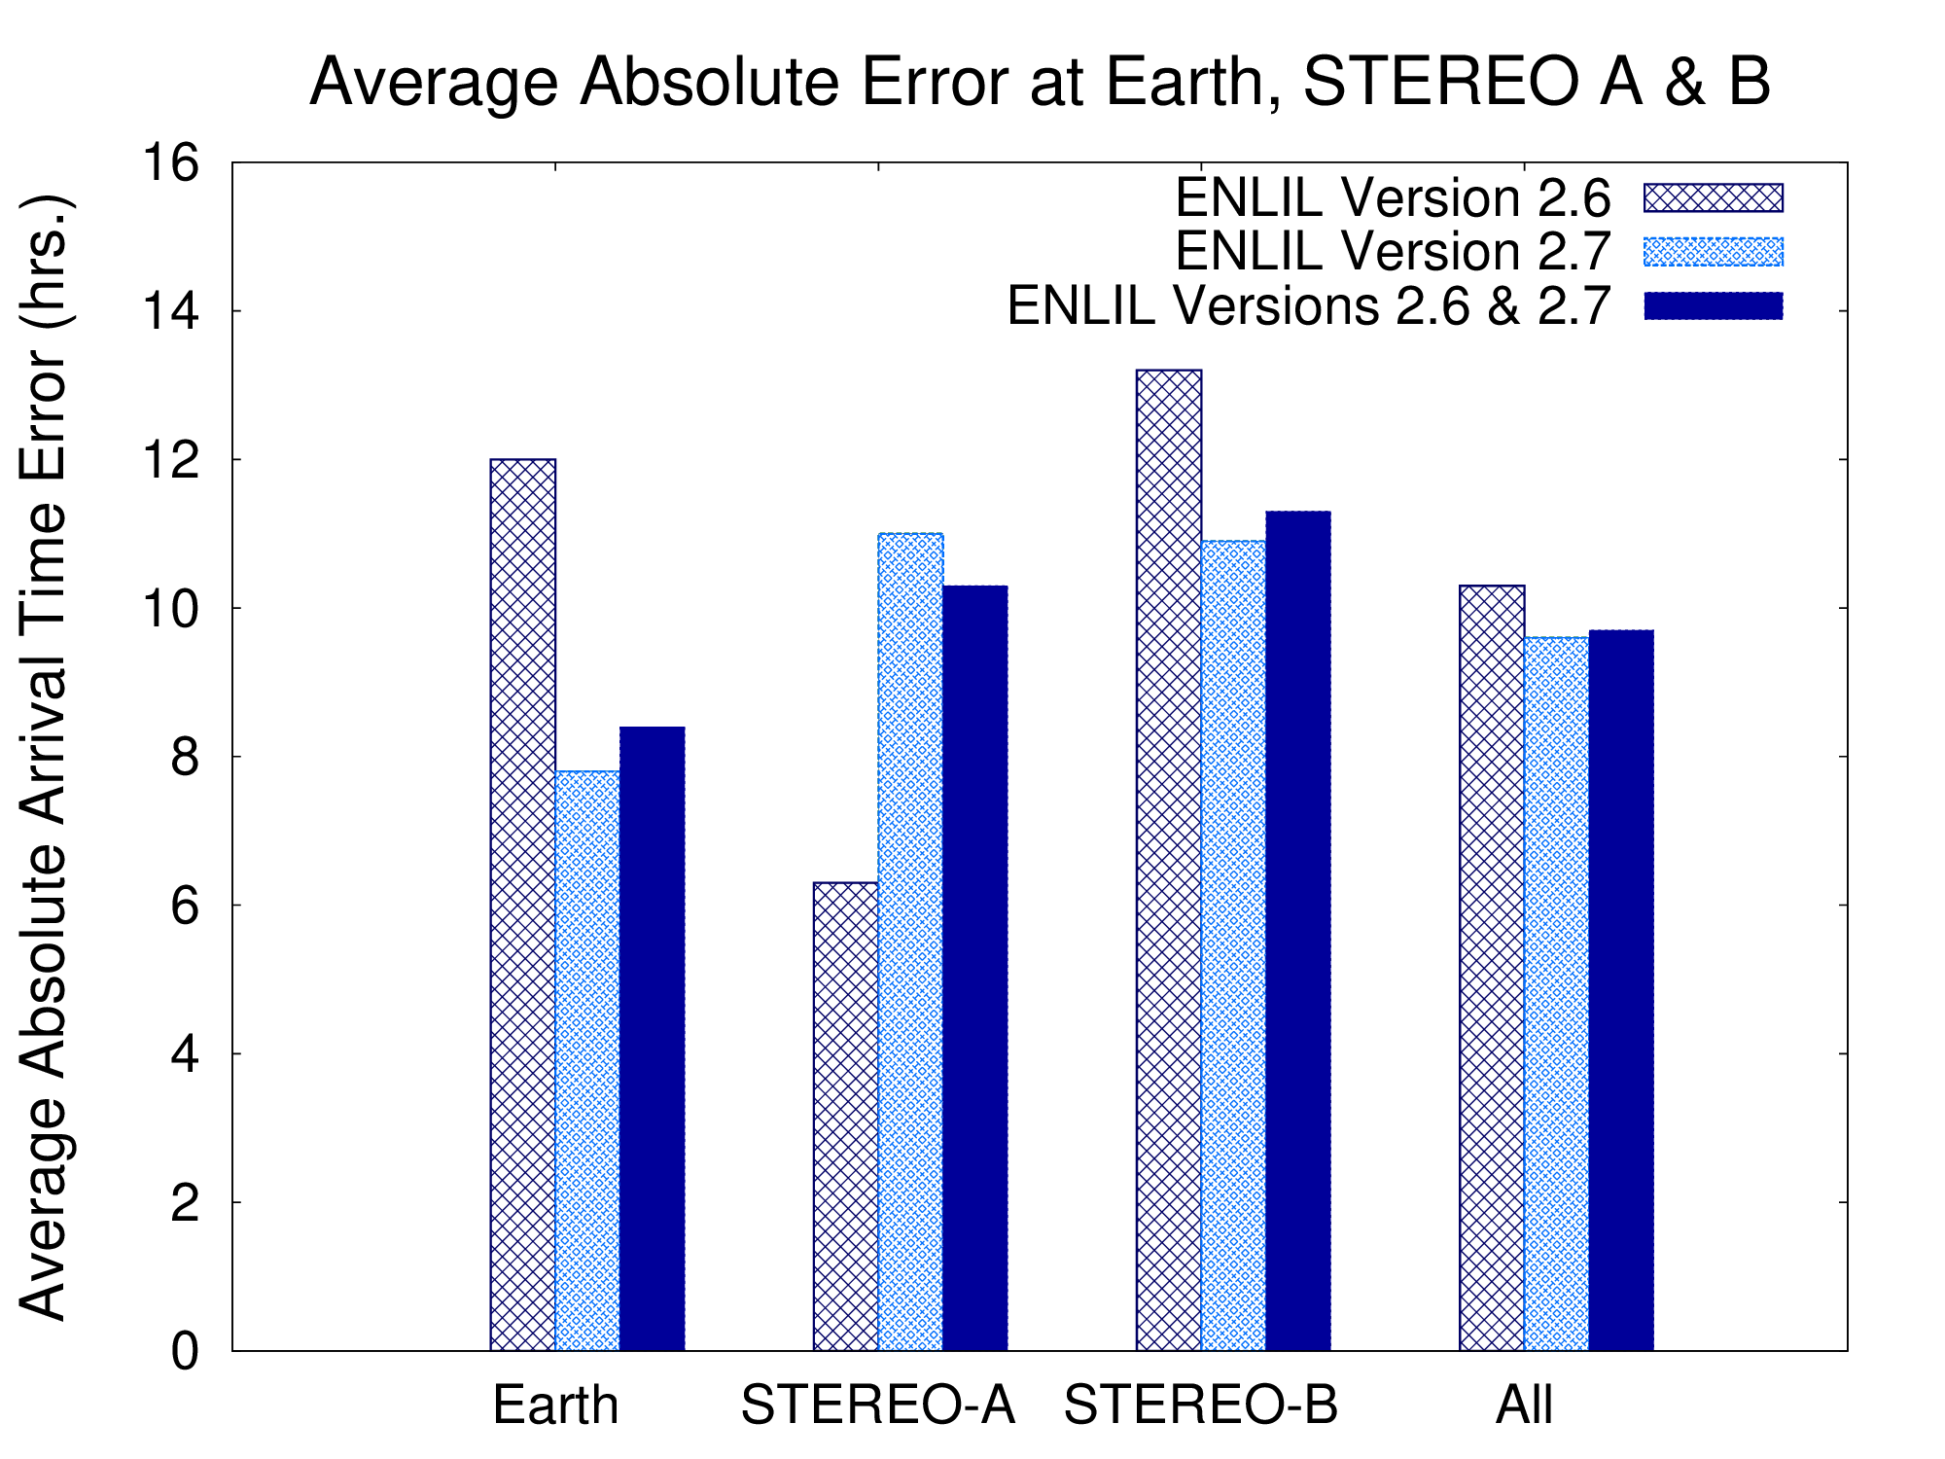
CME arrival time prediction errors
67 hits
53 hits
37 hits
157 hits

Slide 9
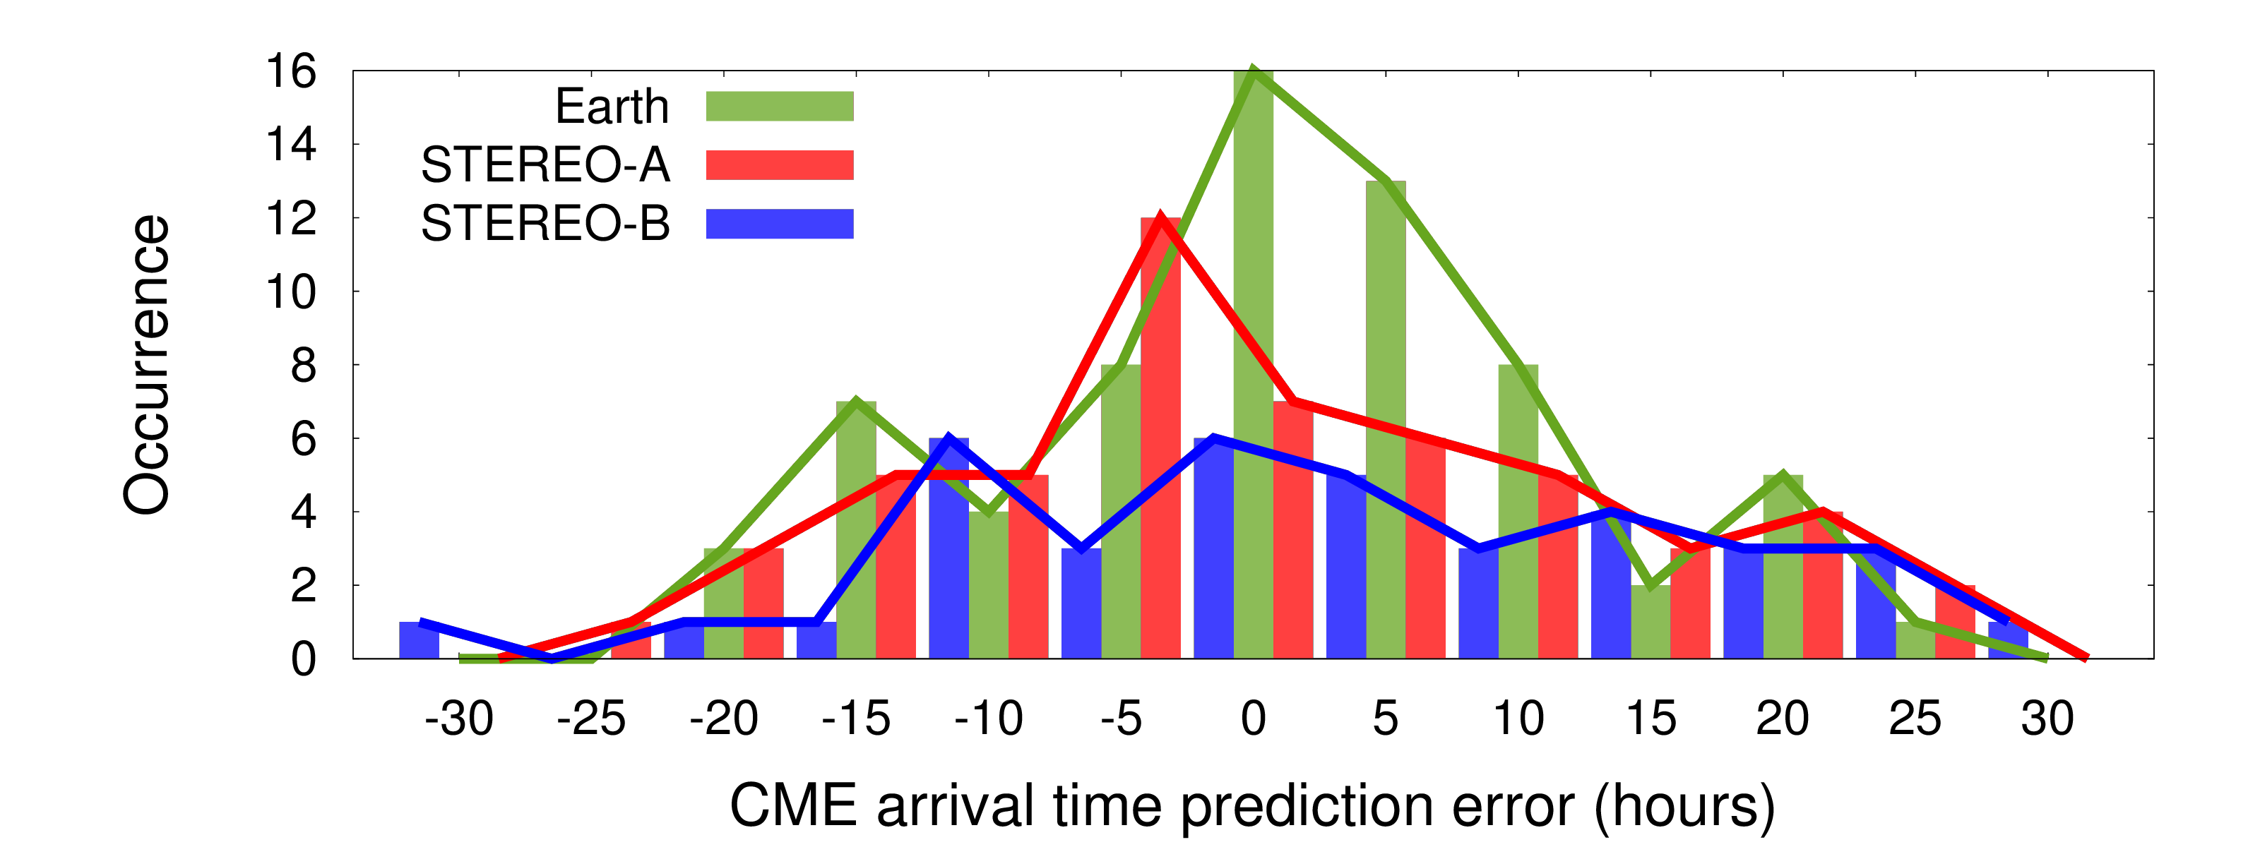
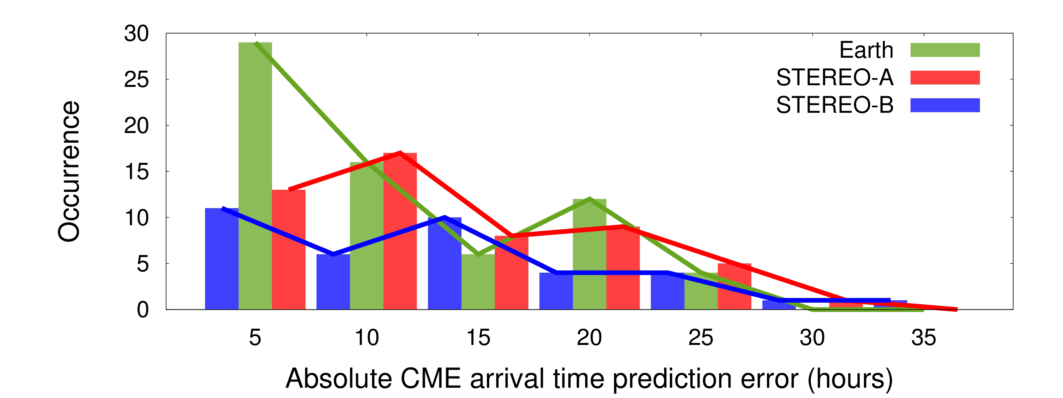
CME arrival time error distributions

Slide 10
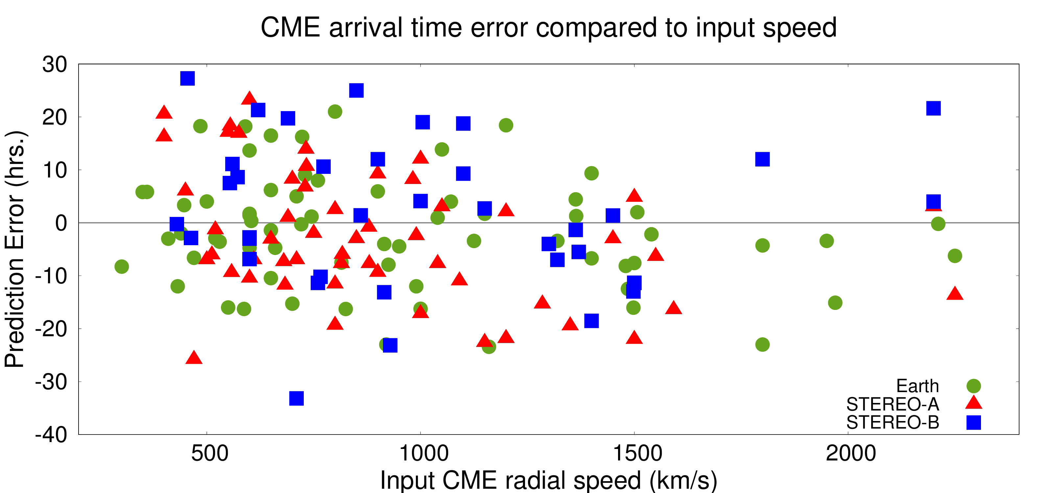
Error & Radial Speed

Slide 11
Conclusions
Future Work
Over 600 simulations (March 2010 - July 2013)
CME arrival time average absolute error at all locations = 9.7 hours
RMSE = 12 hours
Consistent with previous studies
Same analysis through mid 2016
Characterize misses by incorporating the catalogues
Introduce quality factors
Impact of multi-spacecraft observations on the CME parameters used to initialize the model
before and after the STEREO-B communication loss (since September 2014)
STEREO-A side-lobe operations (August 2014-December 2015).
Possibly look at other locations (MESSENGER, Mars)

